Slide 1
MARKETING ANALYTICS
EXAM 1 REVIEW
Professor Sonnier
Fall 2022

Slide 2
EXAM I INFORMATION
EXAM LOGISTICS AND POLICIES
Tuesday Oct 11, 2022 during class session
Exam covers Session 1-Session 10
Multiple choice True/False exam (paper)
You may use Excel or a calculator to perform calculations
Exam will be open notes but class recordings will be disabled
Communication with anyone during the exam is strictly forbidden
Instructor will not answer any questions during the exam

Slide 3
EXAM I INFORMATION
EXAM STRUCTURE
Multiple Choice Questions
Mix of quantitative and conceptual framework questions
Expect no more than 25 questions
Exam drawn from material in lectures, homeworks, and in-class exercises (not the readings)
Be comfortable with the solution principles of the homeworks and in-class exercises.
Interpret results
Use results to compute quantities of interest

Slide 4
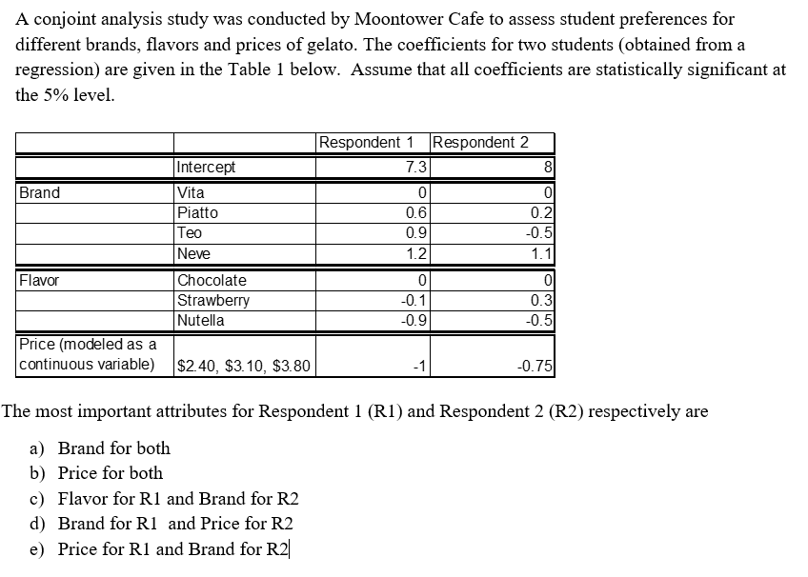
FINAL EXAM
EXAMPLE MULTIPLE CHOICE QUESTIONS

Slide 5
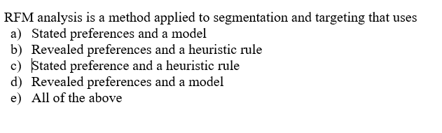
FINAL EXAM
EXAMPLE MULTIPLE CHOICE QUESTIONS

Slide 6
MARKETING ANALYTICS
Key Concepts from Session 1: A Case Study of Kodak
Mathematical Identities
Margins
Profits
Breakeven Volumes
Empirical Relationships
Sales Response Functions
What Variables?
Competitive Effects
Customer Value
Value in Use
Functional Value
Experiential Value

Slide 7
MARKETING ANALYTICS
Key Concepts from Session 2: Value Creation and Value in Use
Consumers derive value from goods and services in different ways
Value in Use
Functional Value
Experiential Value
Value is Use is the value consumers derive from using a good or service relative to the status quo
Value is Use is not generally equal to the price a firm may charge
Competition
Other dimensions of value
Other dimensions of consumer behavior
Creating value in use is not the only determinant of new product adoption
ACCORD

Slide 8
MARKETING ANALYTICS
Key Concepts from Session 3: Customer Mindset Metrics
Brands provide value to customers
Image that consumers demand
Signal of quality
Quantifying the experiential value of a brand or product is challenging
When products are similar in terms of physical characteristics demand analysis provides insights into experiential value
Perceptual maps can be used to visualize brand positions and the relationship between brand preference and brand position

Slide 9
MARKETING ANALYTICS
Key Concepts from Session 4: Analyzing Customer Preferences
Revealed vs. Stated Preferences
Conjoint is a method to measure stated preferences via indirect elicitation
Products are viewed as bundles of attributes (i.e., a laptop is a bundle made up of size of screen, power of processor, amount of memory, brand and price)
Regression analysis of product ratings dependent on product attribute levels
Attribute importance
Dollar-metric valuation
Market share analysis

Slide 10
MARKETING ANALYTICS
Key Concepts from Session 5: Discrete Choice Models
OLS is not well suited to the analysis of discrete choice
By combining behavioral and statistical models we can compute the probability of observing discrete outcomes (i.e., probability of enrollment) conditional on relevant covariates (i.e., GMAT score)
DCM’s differ from linear regression in how we interpret parameters
Pay attention to specification of the intercept!
To assess the impact of a unit change in a covariate X from X0 to X1 we examine
Percentage change in the odds ratio (odds ratio at X0 and X1)
Change in probability given a change in X (choice probability at X0 and X1)

Slide 11
MARKETING ANALYTICS
Key Concepts for Session 6: Choice Based Conjoint Exercise
We generalized binary choice models to multinomial choice models
We are able to generate estimates of the probability of buying conditional on observed product attributes
Unlike linear conjoint we have only an aggregate model to predict probability and market share
Aggregate model can be used to do market share analysis
Model yields counterintuitive patters of cross price effects

Slide 12
MARKETING ANALYTICS
Key Concepts for Session 7: Attitudinal Segmentation
Segmentation benefits firms and consumers
Success requires alignment on a number of factors
Can segment markets on different bases
K-Means cluster analysis is a tool useful for attitudinal segmentation
Finds segments that are within group homogeneous and between group heterogeneous on basis variables

Slide 13
MARKETING ANALYTICS
Key Concepts for Session 8: Preference Segmentation
We can segment consumers on the basis of their preferences
Stated Preferences
Revealed Preferences
Individual level data tells us about differences across units (i.e., customers or stores)
Aggregate analysis gives us more statistical reliability, but at the cost of treating all units (i.e., customers or stores) the same
HB analysis is a tool to combine both sets of information
Unit level information (the individual data)
Information about all units (the prior)

Slide 14
MARKETING ANALYTICS
Key Concepts from Session 9: Recommendation Systems
Types of preference data
Stated preferences
Revealed preference
Models
Heuristic rules are
Simple (relatively!)
Fast
Scalable (usually!)
Examples Include:
User and Item Based Collaborative Filters
Matrix Factorization
Market Basket Analysis

Slide 15
MARKETING ANALYTICS
Key Concepts from Session 10: Behavioral Segmentation
RFM uses rules of thumb derived from past purchase behavior to predict market response
Does not require sophisticated software or analytics
Everyone in an RFM cell shares the same response probability
If we want individual level estimates of probability we need a scoring model
RFM is limited to R, F, M
There may be more predictive information
Propensity scoring models allow us to incorporate other information

